Slide 1
AN INTERNSHIP REPORT ON
Go Home
A Report Submitted to
Blackbuck Engineers Pvt. Ltd
Submitted by
P.Yuvaraj (BBNBP014)
Blackbuck Engineers Pvt. Ltd Road no 36, Jubilee Hills, Hyderabad

Slide 2
TABLE OF CONTENTS
1. INTRODUCTION
7
1.1. SYSTEM OVERVIEW
7
1.2. OBJECTIVE
7
1.3. PROBLEM IDENTIFICATION
7
1.4. APPLICATIONS
7
1.5. LITERATURE SURVEY
8
1.6. LIMITATIONS
8
2. SYSTEM ANALYSIS
9
2.1. EXISTING SYSTEM
9
PROPOSED SYSTEM
On Client Side
On the sponsor side
Company Side
Benefits of Proposed System
3. REQUIREMENT SPECIFICATION
9
9
9
10
10
10
3.1. HARDWARE REQUIREMENTS
10
3.2. SOFTWARE REQUIREMENTS
10
3.3. COMPONENTS USED
10
4. ARCHITECTURE DESIGN SPECIFICATION
11
4.1. SYSTEM ARCHITECTURE
11
11
4.2. DETAILED DESIGN
12
4.3. COMPONENTS USED
5. SYSTEM IMPLEMENTATION
17
5.1. III MODULE
17
6. CONCLUSION AND FUTURE ENHANCEMENTS
18
7. APPENDICES
19
7.1. APPENDIX 1 - SAMPLE SOURCE CODE
19

Slide 3
8. REFERENCES
28
8.1. LIST OF JOURNALS
28
8.2. LIST OF WEBSITES
28
‘

Slide 4
ACKNOWLEDGEMENT
We would like to acknowledge all those without whom this project would not have been successful. Firstly, we would like to thank our Internet and Full stack developer Mr. Ram Kumar who guided us throughout the project and gave his immense support. he made us understand how to complete this project and without his presence, this project would not have been complete. We also got to know a lot about parallelization and its benefits. This project has been a source to learn and bring our theoretical knowledge to the real-life world. Once again, thanks to everyone for making this project successful.
Place :
Date :

Slide 5
ABSTRACT
Now a days the most emerging platform for peoples want to buy and sale a home but they don’t know who are ready to buy or sale a home. so, they want to know who are ready to buy or sale a home and fulfill their dreams using these platform . It is mainly concentrated on interaction between buyers and sellers.
The Go Home Project is a comprehensive web-based platform designed to facilitate the buying and selling of residential real estate properties. It serves as an all-encompassing ecosystem for users, which primarily includes buyers and sellers, and provides them with the tools and resources necessary to navigate the real estate market seamlessly.

Slide 6
INTRODUCTION
1.1 SYSTEM OVERVIEW
This is an innovative and user-centric web-based platform created to simplify the intricate process of buying and selling residential real estate properties. Its core mission is to establish a seamless and secure online marketplace that seamlessly connects property buyers and sellers, enabling them to interact efficiently. At its heart, this system offers a sophisticated user management framework, empowering individuals and real estate professionals to register, authenticate, and manage their profiles. Sellers can meticulously list properties, providing comprehensive details and multimedia content to entice potential buyers, while buyers can efficiently search for properties that match their criteria. The system integrates secure payment processing, fostering confidence in transactions, and ensuring users have access to their transaction history. Users can also personalize their experience through customization options, with dedicated support channels available to resolve inquiries promptly. Security is paramount, with robust measures in place to protect sensitive data.
Hence the main objective of this web portal is to have an interaction between the sellers and the buyers for their requirements financially.
1.2. OBJECTIVE
This project consists of a web portal in which is to revolutionize and simplify the real estate market by providing a robust and user-friendly online platform for buying and selling residential properties. Our goal is to create an ecosystem that seamlessly connects property buyers and sellers, offering them a secure, efficient, and feature-rich marketplace to transact with confidence. By focusing on user management, property listings, property searches, secure transactions, customization, and unwavering security, we aim to empower individuals and real estate professionals alike. Our overarching mission is to facilitate informed and hassle-free property transactions while enhancing the overall user experience.
1.3. PROBLEM IDENTIFICATION
These are some of the problems faced by a person who wants to start a start-up!
Financial Resources
Revenue
Team
Supporting Infrastructure
Creating Awareness in Markets
Exceed Customer
Tenacity of Founders
Regulations
Growth
Lack of Mentorship
Lack of a Good Branding Strategy
Can be used by anyone.

Slide 7
1.4. APPLICATIONS
This web application can be used by any company to invest in new ventures
Angel Investors can have a look at this website.
Local Area Information
New ideas can be implemented.
There is no domain limitation
Can be used by anyone.
1.5. LITERATURE SURVEY
1. Introduction to Web Development:
Provide an overview of web development and its significance in modern applications.
Include references or links to foundational web development concepts, such as HTML, CSS, and JavaScript.
2.Frontend Development:
Discuss frontend technologies like HTML,HTML5,CSS,CSS3,javascript,React which may be used in conjunction with Go Home for building the user interface.
Recommend literature or tutorials on frontend development to complement your Go Home project.
3.Authentication and Authorization:
Reference materials on implementing user authentication and authorization in web applications.
Mention Go-specific libraries or packages for user management and security.
4.Security Best Practices:
Include references to security guidelines and best practices for web applications, including topics like input validation, encryption, and cross-site scripting (javascript) prevention.
5.Performance Optimization:
Reference literature on optimizing the performance of Go applications, including profiling, caching, and load balancing techniques.
6.Version Control and Collaboration:
Recommend literature on using version control systems like Git and collaborating with development teams.
7.Project Management:
Provide references to project management methodologies, such as Agile or Scrum, to enhance development processes.
8.Community and Support:
Mention web-related forums, mailing lists, and communities where developers can seek help and share experiences.
9.Case Studies and Real-world Examples:
Include references to real-world web-based web applications or success stories for inspiration.

Slide 8
SYSTEM ANALYSIS
EXISTING SYSTEM
Nearly Most of the Reputed Institutes are supporting their Student's Start-up Ideas.
They are encouraging students to make their start-up recognized by the "Start-up India" Program. The funding for these startups is given by their Universities.
The selection of items would be based on the entrepreneurs’ expertise and the area of operation.
Online food delivery | FRESHMENU, SWIGGY
Online fish, meat delivery | FRESHTOHOME
Big data analytics for trade | PEELWORKS
Online pharmacy | MYRA
PROPOSED SYSTEM
On Client Side
Client gets registered by submitting the specified Home pictutes.
Once the registration part is verified then the client can send a request to the sponsor.
The client can also post the Abstract to the open Stack of Abstract which will appear to everyone.
2.2.2. On the sponsor side
I. The sponsor gets registered by submitting the specified Documents.

Slide 9
Once the registration part is verified then the Sponsor can start selecting the satisfied Themes of Startups.
If the Sponsor is Interested in a Start-Up Idea, then the sponsor can contact the Client.
The Sponsors can expect the shares of the company or the percentage in profits as in the return of Investment.
2.2.3. Company Side
The Admin of the Company must verify the documents submitted by the Client and the sponsor, if there is any issue in verification the admin must contact the user.
The admin must conduct a meeting for both the sponsor and the client for confirming the Legal conditions accepted between them.
2.2.4. Benefits of Proposed System
This website provides security for ideas provided by the clients and professional agreement will be given.
REQUIREMENT SPECIFICATION
HARDWARE REQUIREMENTS
Laptop 4 GHz minimum, multi-core processor
Memory (RAM) 8GB, preferably higher, and commensurate with concurrent usage
Hard disk space 1TB
3.2. SOFTWARE REQUIREMENTS
Windows 2016
Visual Studio Code
Notepad++
Xampp/ Apache web server
3.3. COMPONENTS USED
Google Chrome
Mozilla Firefox
Microsoft Edge
Safari

Slide 10
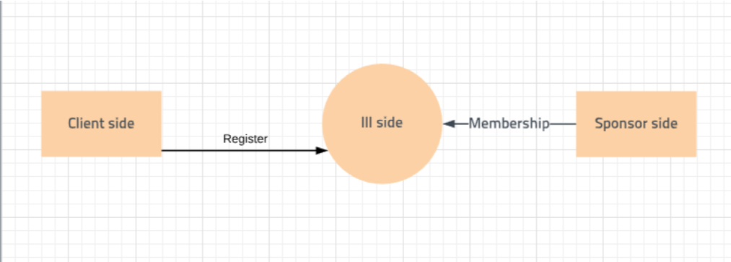
ARCHITECTURE DESIGN SPECIFICATION
SYSTEM ARCHITECTURE
In this project, there will be three sides.
Client side
III Side
Sponsor side
Client usually register and implement their ideas in the III
Sponsor sign up and check the available ideas and implement by investing.
III make sure by approving the credentials for Client and Sponsor. III can see ideas and sponsorships
which are offered.
III will be in higher tier followed by Sponsor side and Client Side
Signup and sign in will be the same portal for all the sides. But the location will be based on the modules

Slide 11
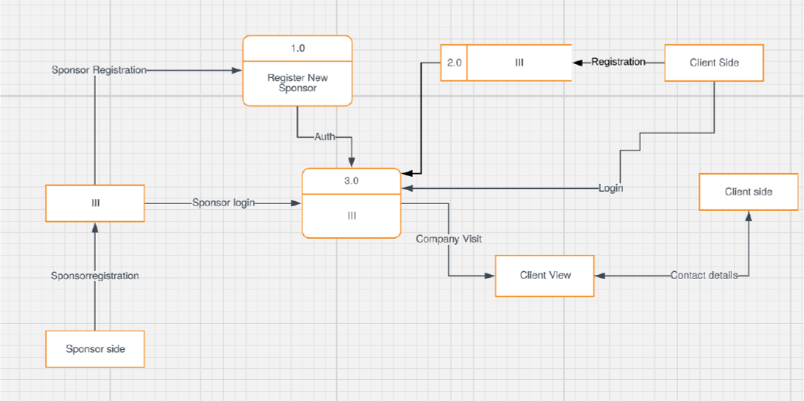
4.2. DETAILED DESIGN
Sponsor Side
Sponsors first need to sign up and after verification, credentials will be available. Sponsor can see all the ideas available and likely to invest.
Sponsor can invest after agreeing to the required terms and conditions.
III Side
III approves the request after verification from the user. III can see all the available ideas and projects.
III can monitor the sponsorships approved by the Sponsor for an Idea.
Client Side
Sponsors first need to sign up and after verification, credentials will be available. Client can request for any number of projects
Clients either cancel or approve the request sent by the Sponsor .
4.3. COMPONENTS USED
HTML
CSS
HTML5
CSS3
Java Script
React Js

Slide 12
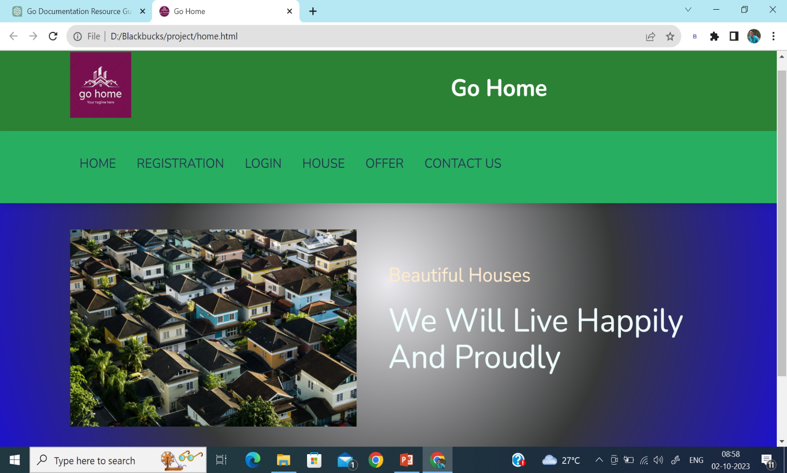
5. SYSTEM IMPLEMENTATION
5.1. III MODULE
This is a screenshot of our website home page where we can see some information about us. Here, It includes three pages which include Loginpage, About page, Home page.
Fig 1. Home page

Slide 13
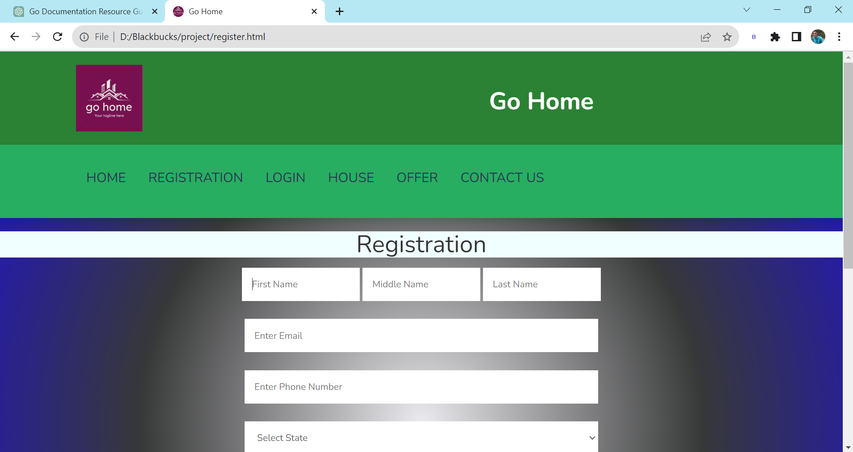
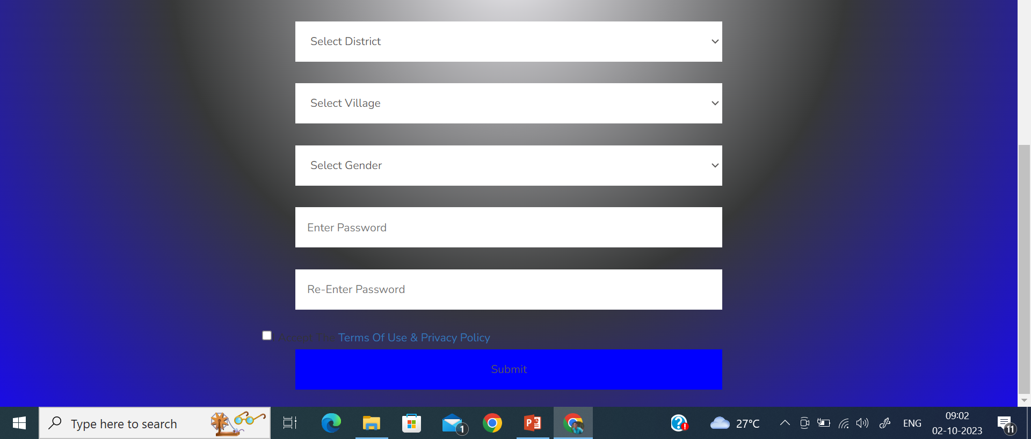
Fig 2. Registration page

Slide 14
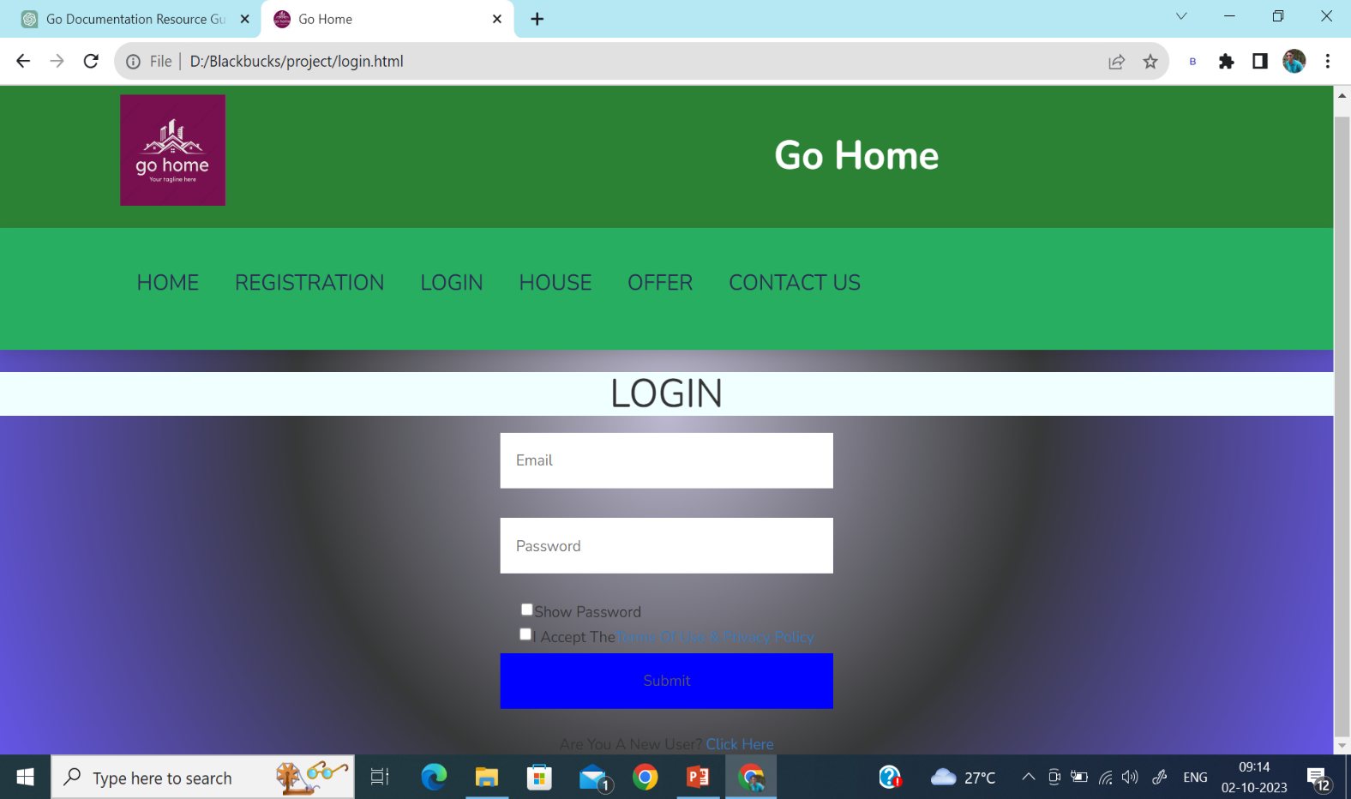
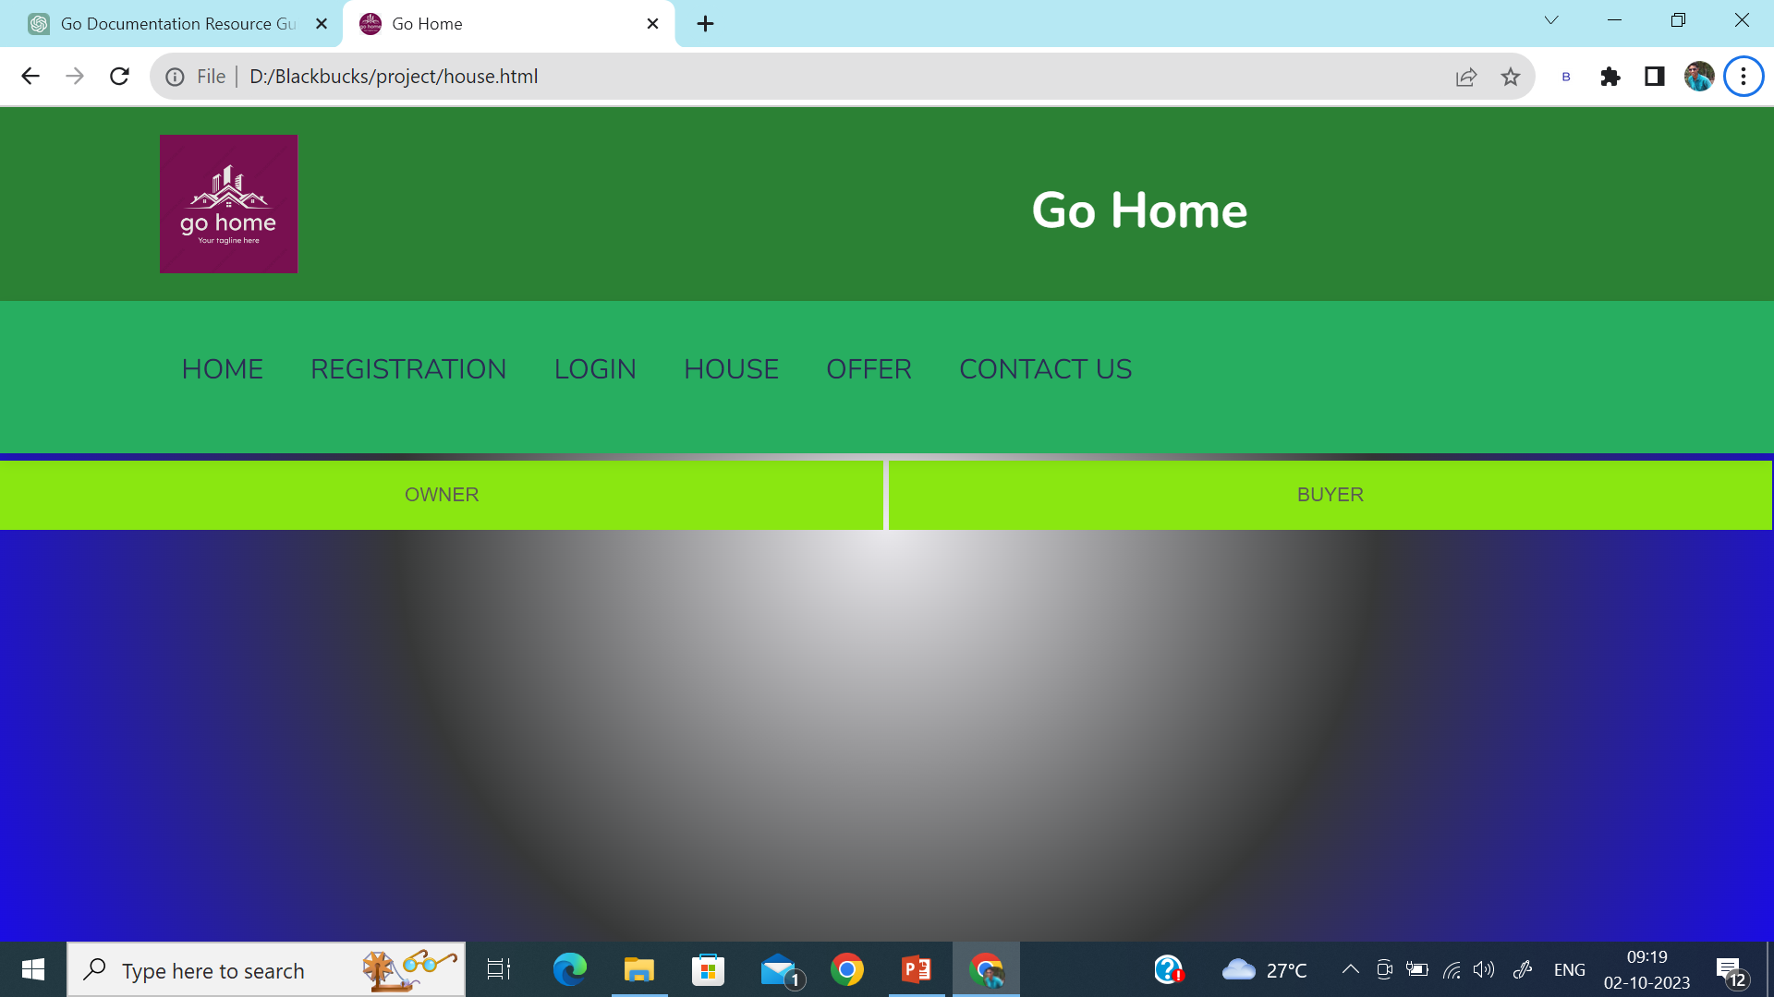
Fig3.Login page
Fig4.House page
This house module have two sub modules:
Owner
buyer

Slide 15
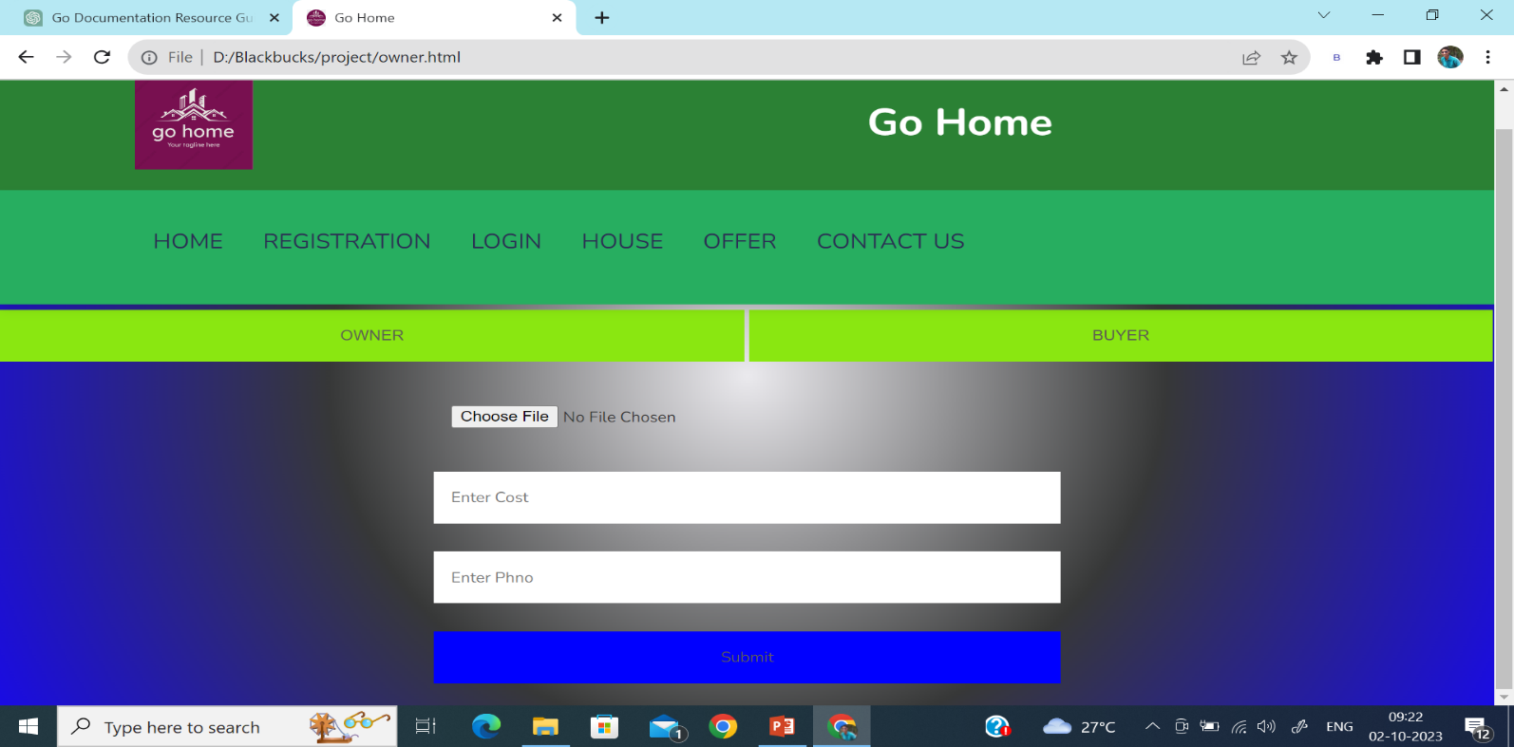
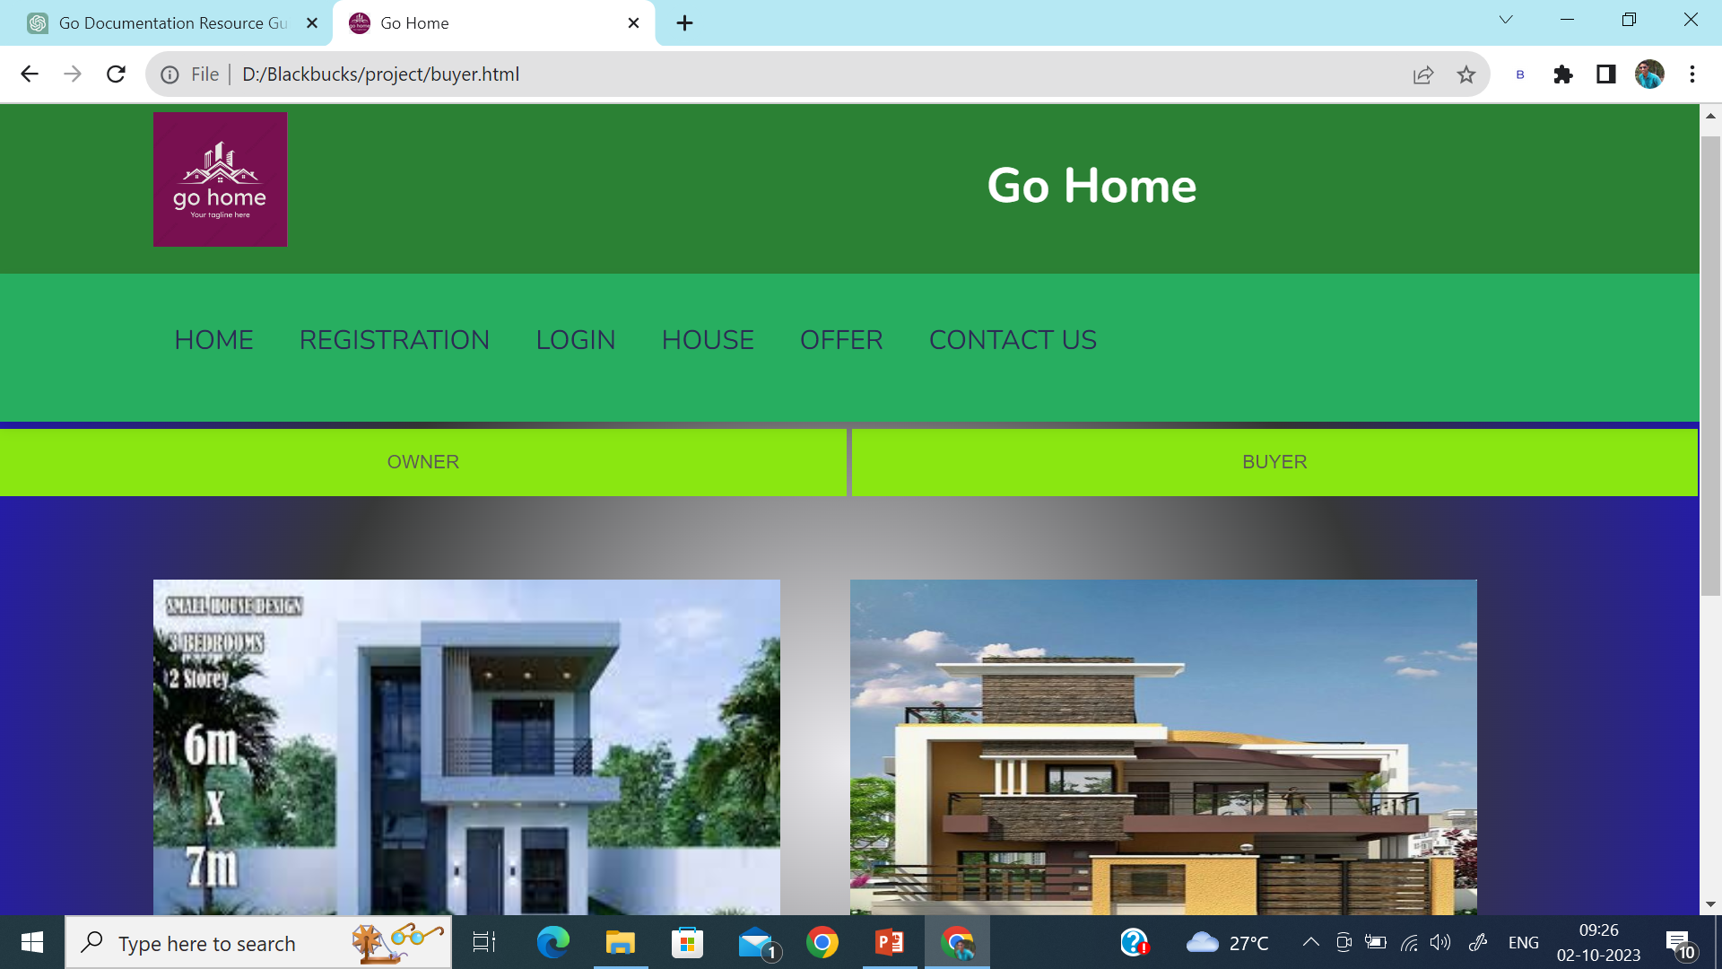
Fig4.1 Owner page
Fig 4.2 Buyer page

Slide 16
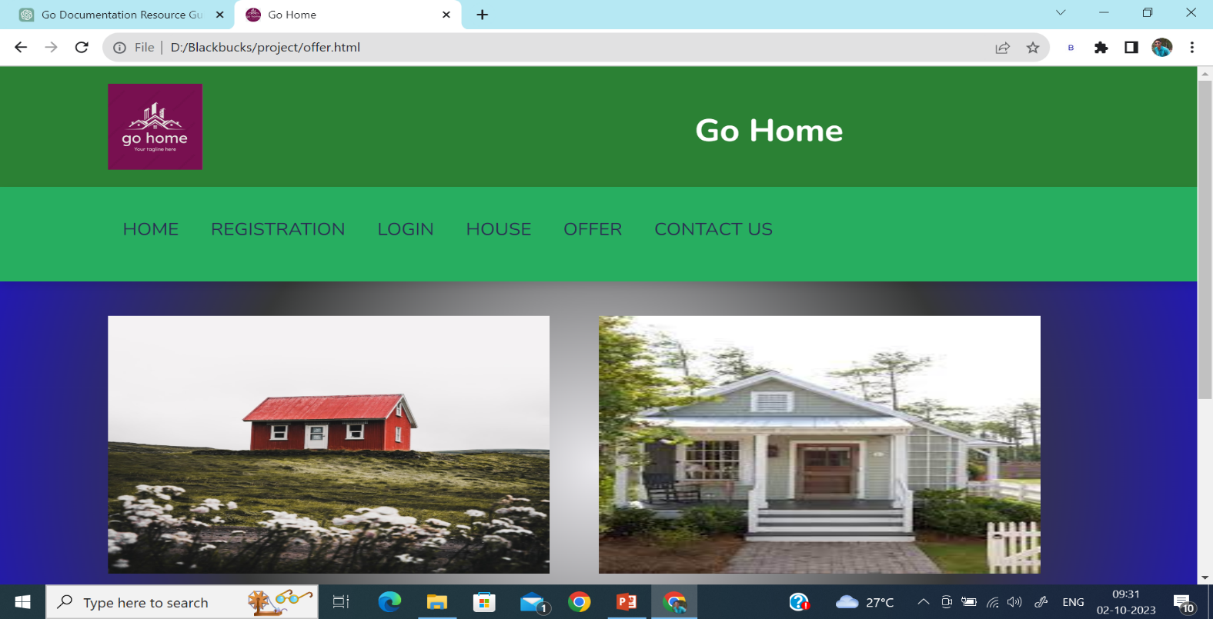
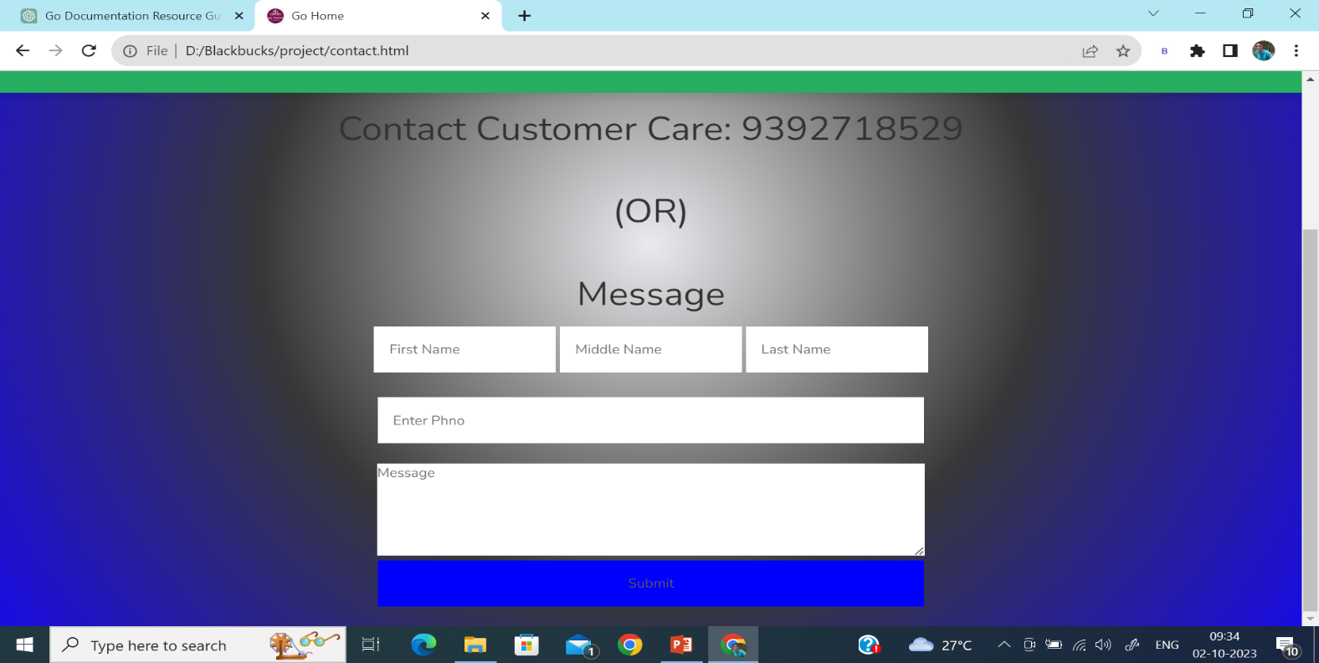
Fig 5. Offer page
Fig 6. Contact us page

Slide 17
6. CONCLUSION AND FUTURE ENHANCEMENTS
In this web application, we have many functionalities like client-sponsor interaction, fund raising, funds approval etc.., This is a new idea which can be implemented on large scale and it helps to emerge new companies and a help hand for the needy companies. This web application covered all the required functionalities and also developed with PHP using Mysql in the backend. There are various applications like LinkedIn, Internshala etc.., which work in the similar domain.
For the future vision, this project can be implemented in large scale using Google Firebase as backend which integrates mobile applications along with the web application. To ensure more security, this project can be integrated with block chain and AI. Now, we have seen many security features like face recognition using AI and Ml,2 step verification etc.There is a lot of scope for this application and it really helps for the new generation who wants to achieve more through Start-ups.

Slide 18
7. APPENDICES
7.1. APPENDIX 1 - SAMPLE SOURCE CODE
Home.html
<html>
<head>
<title>Go Home</title>
<meta charset="utf-8">
<link rel = "icon" href ="gohome1.png" type = "image/x-icon">
<meta name="viewport" content="width=device-width, initial-scale=1">
<link rel="stylesheet" href="https://maxcdn.bootstrapcdn.com/bootstrap/3.4.1/css/bootstrap.min.css">
<script src="https://ajax.googleapis.com/ajax/libs/jquery/3.5.1/jquery.min.js"></script>
<script src="https://maxcdn.bootstrapcdn.com/bootstrap/3.4.1/js/bootstrap.min.js"></script>
<link rel="stylesheet" href="styler.css">
</head>
<body>
</head>
<body>
<header>
<div class="header-1">
<img border="0" src="gohome.png" alrt="Image is not there" width="100" height="100"/>
<p class="logo" >
<h1 style="color:white"><strong>Go Home</strong></h1></p>
</div>
<div class="header-2">
<div id="menu-bar" class="fas fa-bars"></div>
<nav class="navbar">
<a href="home.html" class="btn" role="button" style="border: green;" >HOME</a>
<a href="register.html" class="btn btn-info" role="button" style="border: green;" >REGISTRATION</a>
<a href="login.html" class="btn btn-info" role="button" style="border: green;">LOGIN</a>
<a href="house.html" class="btn btn-info" role="button" style="border: green;">HOUSE</a>
<a href="offer.html" class="btn btn-info" role="button" style="border: green;" >OFFER</a>
<a href="contact.html" class="btn btn-info" role="button" style="border: green;" >CONTACT US</a>
</nav>
</div>
</header>

Slide 19
<section class="home" id="home">
<div class="image">
<img src="homesimage.jpg" alt="" height="300" width="500">
</div>
<div class="content">
<span style="color: blanchedalmond;">Beautiful Houses</span>
<h3 style="color: azure;">We Will live Happily and Proudly</h3>
</div>
</section>
<h3 style="color: azure;">“A house is made of walls and beams; a home is built of love and dreams and Home isn't where you're from, it's where you find light when all grows dark.” </h3>
<center><h3 style="color: rgb(9, 167, 43);">"So Choose Right Home"</h3></center>
</body>
</html>
Register.html
<html>
<head>
<title>Go Home</title>
<meta charset="utf-8">
<link rel = "icon" href ="gohome1.png" type = "image/x-icon">
<meta name="viewport" content="width=device-width, initial-scale=1">
<link rel="stylesheet" href="https://maxcdn.bootstrapcdn.com/bootstrap/3.4.1/css/bootstrap.min.css">
<script src="https://ajax.googleapis.com/ajax/libs/jquery/3.5.1/jquery.min.js"></script>
<script src="https://maxcdn.bootstrapcdn.com/bootstrap/3.4.1/js/bootstrap.min.js"></script>
<link rel="stylesheet" href="styler.css">
</head>
<body>
</head>
<body>
<header>
<div class="header-1">
<img border="0" src="gohome.png" alrt="Image is not there" width="100" height="100"/>
<p class="logo" >
<h1 style="color:white"><strong>Go Home</strong></h1></p>
</div>
<div class="header-2">
<div id="menu-bar" class="fas fa-bars"></div>
<nav class="navbar">
<a href="home.html" class="btn" role="button" style="border: green;" >HOME</a>
<a href="register.html" class="btn btn-info" role="button" style="border: green;" >REGISTRATION</a>

Slide 20
<a href="login.html" class="btn btn-info" role="button" style="border: green;">LOGIN</a>
<a href="house.html" class="btn btn-info" role="button" style="border: green;">HOUSE</a>
<a href="offer.html" class="btn btn-info" role="button" style="border: green;" >OFFER</a>
<a href="contact.html" class="btn btn-info" role="button" style="border: green;" >CONTACT US</a>
</nav>
</div>
</header>
<form action="#" onsubmit="return passval(this);">
<center><h1 style="background-color: azure;">Registration</h1>
<input type="text" name="fname" placeholder="First Name" autofocus>
<input type="text" name="mname" placeholder="Middle Name">
<input type="text" name="lname" placeholder="Last Name"><br>
<input type="email" name="mailid" placeholder="Enter Email" pattern=".+@gmail\.com"><br>
<input type="tel" name="phno" placeholder="Enter phone Number" size="10"><br>
<select>
<option>Select State</option>
<option>Andra Pradesh</option>
<option>Telangana</option>
<option>Uthar Pradesh</option>
</select><br>
<select>
<option>Select District</option>
<option>Nellore</option>
<option>Tirupati</option>
<option>Kurnool</option>
<option>Kadapa</option>
</select><br>
<select>
<option>Select Village</option>
<option>Gudur</option>
<option>Vidyanagar</option>
<option>Kota</option>
<option>Vakadu</option>
</select><br>
<select>
<option>Select Gender</option>
<option>Male</option>
<option>Female</option>
<option>Trans</option>
</select><br>
<input type="password" name="pass1" placeholder="Enter password"><br>
<input type="password" name="pass2" placeholder="Re-enter password"><br>
</center>
&nbsp;&nbsp;&nbsp;&nbsp;&nbsp;&nbsp;&nbsp;&nbsp;&nbsp;&nbsp;&nbsp;&nbsp;&nbsp;&nbsp;&nbsp;&nbsp;&nbsp;&nbsp;&nbsp;&nbsp;&nbsp;&nbsp;&nbsp;&nbsp;&nbsp;&nbsp;&nbsp;&nbsp;&nbsp;&nbsp;&nbsp;&nbsp;&nbsp;&nbsp;&nbsp;&nbsp;&nbsp;&nbsp;&nbsp;&nbsp;&nbsp;&nbsp;&nbsp;&nbsp;&nbsp;&nbsp;&nbsp;&nbsp;&nbsp;&nbsp;&nbsp;&nbsp;&nbsp;&nbsp;&nbsp;&nbsp;&nbsp;&nbsp;&nbsp;&nbsp;&nbsp;&nbsp;&nbsp;&nbsp;&nbsp;&nbsp;&nbsp;&nbsp;&nbsp;&nbsp;&nbsp;&nbsp;&nbsp;&nbsp;&nbsp;&nbsp;&nbsp;&nbsp;&nbsp;&nbsp;&nbsp;&nbsp;&nbsp;&nbsp;&nbsp;&nbsp;&nbsp;&nbsp;&nbsp;&nbsp;<input type="checkbox" name="check" style="color: beige;">I

Slide 21
<input type="checkbox" name="check" style="color: beige;">I Accept the <a href="#">Terms of Use & Privacy Policy</a><br>
<center><input type="submit" name="Register"></center>
</form>
<script>
var p1=form.pass1.value;
var p2=form.pass2.value;
function passval(form){
if (p1!=0 && p2!=0){
if (p1===p2){
return true
}
return false
}
else{
return false
}
}
</script>
</body>
</html>
Login.html
<html>
<head>
<title>Go Home</title>
<meta charset="utf-8">
<link rel = "icon" href ="gohome1.png" type = "image/x-icon">
<meta name="viewport" content="width=device-width, initial-scale=1">
<link rel="stylesheet" href="https://maxcdn.bootstrapcdn.com/bootstrap/3.4.1/css/bootstrap.min.css">
<script src="https://ajax.googleapis.com/ajax/libs/jquery/3.5.1/jquery.min.js"></script>
<script src="https://maxcdn.bootstrapcdn.com/bootstrap/3.4.1/js/bootstrap.min.js"></script>
<link rel="stylesheet" href="stylel.css">
</head>
<body>
<header>
<div class="header-1">
<img border="0" src="gohome.png" alrt="Image is not there" width="100" height="100"/>
<p class="logo" >
<h1 style="color:white"><strong>Go Home</strong></h1></p>
</div>
<div class="header-2">
<div id="menu-bar" class="fas fa-bars"></div>
<nav class="navbar">
<a href="home.html" class="btn" role="button" style="border: green;" >HOME</a>
<a href="register.html" class="btn btn-info" role="button" style="border: green;" >REGISTRATION</a>
<a href="login.html" class="btn btn-info" role="button" style="border: green;">LOGIN</a>

Slide 22
<a href="house.html" class="btn btn-info" role="button" style="border: green;">HOUSE</a>
<a href="offer.html" class="btn btn-info" role="button" style="border: green;" >OFFER</a>
<a href="contact.html" class="btn btn-info" role="button" style="border: green;" >CONTACT US</a>
</nav>
</div>
</header>
<form action="#" onsubmit="return myvalidate(this);">
<center>
<h1 style="background-color: azure;">LOGIN</h1>
<input type="email" name="mailid" placeholder="Email" pattern=".+@gmail\.com"autofocus><br>
<input type="password" name="password" placeholder="password" id="myInput"><br>
<input type="checkbox" onclick="myFunction()">Show password &nbsp;&nbsp;&nbsp;&nbsp;&nbsp;&nbsp;&nbsp;&nbsp;&nbsp;&nbsp;&nbsp;&nbsp;&nbsp;&nbsp;&nbsp;&nbsp;&nbsp;&nbsp;&nbsp;&nbsp;&nbsp;&nbsp;&nbsp;&nbsp;&nbsp;&nbsp;&nbsp;&nbsp;&nbsp;&nbsp;&nbsp;&nbsp;&nbsp;&nbsp;&nbsp;&nbsp;&nbsp;&nbsp;&nbsp;&nbsp;&nbsp;&nbsp;&nbsp;&nbsp;<br>
<input type="checkbox" name="check">I Accept the<a href="#">Terms of Use & Privacy Policy</a><br>
<input type="submit" placeholder="LOGIN"><br>
Are you a new user? <a href="register.html">click here</a>
</center>
</form>
<script>
function myFunction() {
var x = document.getElementById("myInput");
if (x.type === "password") {
x.type = "text";
} else {
x.type = "password";
}
}
function myvalidate(form) {
var userName = form.mailid.value;
var password = form.password.value;
if(userName.length === 0) {
alert("You Must Enter valid Email ");
return false;
}
if(password.length === 0) {
alert("You Must Enter valid Password ");
return false;
}
return true;
}
</script>
</body>
</html>

Slide 23
House.html
<html>
<head>
<title>Go Home</title>
<meta charset="utf-8">
<link rel = "icon" href ="gohome1.png" type = "image/x-icon">
<meta name="viewport" content="width=device-width, initial-scale=1">
<link rel="stylesheet" href="https://maxcdn.bootstrapcdn.com/bootstrap/3.4.1/css/bootstrap.min.css">
<script src="https://ajax.googleapis.com/ajax/libs/jquery/3.5.1/jquery.min.js"></script>
<script src="https://maxcdn.bootstrapcdn.com/bootstrap/3.4.1/js/bootstrap.min.js"></script>
<link rel="stylesheet" href="styler.css">
</head>
<body>
</head>
<body>
<header>
<div class="header-1">
<img border="0" src="gohome.png" alrt="Image is not there" width="100" height="100"/>
<p class="logo" >
<h1 style="color:white"><strong>Go Home</strong></h1></p>
</div>
<div class="header-2">
<div id="menu-bar" class="fas fa-bars"></div>
<nav class="navbar">
<a href="home.html" class="btn" role="button" style="border: green;" >HOME</a>
<a href="register.html" class="btn btn-info" role="button" style="border: green;" >REGISTRATION</a>
<a href="login.html" class="btn btn-info" role="button" style="border: green;">LOGIN</a>
<a href="house.html" class="btn btn-info" role="button" style="border: green;">HOUSE</a>
<a href="offer.html" class="btn btn-info" role="button" style="border: green;" >OFFER</a>
<a href="contact.html" class="btn btn-info" role="button" style="border: green;" >CONTACT US</a>
</nav>
</div>
</header>
<button type="button" name="OWNER" onclick="window.location.href='owner.html';">OWNER</button>
<button type="button" name="OWNER" onclick="window.location.href='buyer.html';">BUYER</button>
</body>
</html>

Slide 24
Offer.html
<html>
<head>
<title>Go Home</title>
<meta charset="utf-8">
<link rel = "icon" href ="gohome1.png" type = "image/x-icon">
<meta name="viewport" content="width=device-width, initial-scale=1">
<link rel="stylesheet" href="https://maxcdn.bootstrapcdn.com/bootstrap/3.4.1/css/bootstrap.min.css">
<script src="https://ajax.googleapis.com/ajax/libs/jquery/3.5.1/jquery.min.js"></script>
<script src="https://maxcdn.bootstrapcdn.com/bootstrap/3.4.1/js/bootstrap.min.js"></script>
<link rel="stylesheet" href="styler.css">
</head>
<body>
</head>
<body>
<header>
<div class="header-1">
<img border="0" src="gohome.png" alrt="Image is not there" width="100" height="100"/>
<p class="logo" >
<h1 style="color:white"><strong>Go Home</strong></h1></p>
</div>
<div class="header-2">
<div id="menu-bar" class="fas fa-bars"></div>
<nav class="navbar">
<a href="home.html" class="btn" role="button" style="border: green;" >HOME</a>
<a href="register.html" class="btn btn-info" role="button" style="border: green;" >REGISTRATION</a>
<a href="login.html" class="btn btn-info" role="button" style="border: green;">LOGIN</a>
<a href="house.html" class="btn btn-info" role="button" style="border: green;">HOUSE</a>
<a href="offer.html" class="btn btn-info" role="button" style="border: green;" >OFFER</a>
<a href="contact.html" class="btn btn-info" role="button" style="border: green;" >CONTACT US</a>
</nav>
</div>
</header>
<section class="home" id="home">
<div class="image">
<img src="img1.jpeg" alt="" height="300" width="500">
</div>
<div class="image">
<img src="img2.jpeg" alt="" height="300" width="500">
</div>
<div class="image">
<img src="img3.jpeg" alt="" height="300" width="500">
</div>
</section>
</body>
</html>

Slide 25
Contact.html
<!DOCTYPE html>
<html lang="en">
<head>
<title>Bootstrap Example</title>
<meta charset="utf-8">
<meta name="viewport" content="width=device-width, initial-scale=1">
<link rel="stylesheet" href="https://maxcdn.bootstrapcdn.com/bootstrap/3.4.1/css/bootstrap.min.css">
<script src="https://ajax.googleapis.com/ajax/libs/jquery/3.6.0/jquery.min.js"></script>
<script src="https://maxcdn.bootstrapcdn.com/bootstrap/3.4.1/js/bootstrap.min.js"></script>
<link rel="stylesheet" href="style.css">
<style>
.bg{
border: 5px skyblue;
display: flex;
justify-content: center;
background-image: url(images/conta.jpg);
height:450px;
width: 1300px;
background-position: center;
background-repeat: no-repeat;
background-size: cover;
}
</style>
</head>
<body>
<header>
<div class="header-2">
<div id="menu-bar" class="fas fa-bars"></div>
<nav class="navbar">
<a href="home.html" class="btn" role="button" style="border: green;" >HOME</a>
<a href="Registration-css.html" class="btn btn-info" role="button" style="border: green;" >ACCOUNT CREATION</a>
<a href="loginpage.html" class="btn btn-info" role="button" style="border: green;">LOGIN</a>
<a href="veg.html" class="btn btn-info" role="button" style="border: green;">VEGETABLES</a>
<a href="offerpage.html" class="btn btn-info" role="button" style="border: green;" >OFFER</a>
<a href="contact.html" class="btn btn-info" role="button" style="border: green;" >CONTACT US</a>
</nav>
</div>
</header>

Slide 26
<div class="bg">
<form action="ContactSuccess.html">
<h1 align="center"><strong>CONTACT US</strong></h1>
<p> <strong>Full Name:</strong>
<input type= "text" name="fname" >
<p><strong>Phone number:</strong>
<input type="tel" name="phone" pattern="^\d{10}$" required>
</p>
<p><strong>Email:</strong>
<input type="email" name="Email" required>
</p>
<p><strong>Message:</strong>
</p>
<p>
<textarea placeholder="message" name="" id="" cols="30" rows="10"></textarea>
</p>
</hr>
<p>
<strong><input type="submit" value="SEND"></strong>
</p>
</form>
</div>
</body>
</html>

Slide 27
REFERENCES
8.2. LIST OF WEBSITES
https://www.apachefriends.org/download.html
https://code.visualstudio.com/download
https://www.php.net/downloads.php
https://www.researchgate.net/publication/347392298_Start- Ups_Evaluation_With_The_Help_Of_Web-Based_Platforms
https://www.researchgate.net/publication/346557861_Business_ideas_in_start-ups
https://www.researchgate.net/publication/287307261_Analysis_of_financing_sources
_for_start-up_companies/citation/download
https://www.researchgate.net/publication/352559631_Startups_and_Sources_of_Fund ing
https://www.geeksforgeeks.com

